Slide 1
Optimizing Ultrasound Simulation
Adam Gleichman

Slide 2

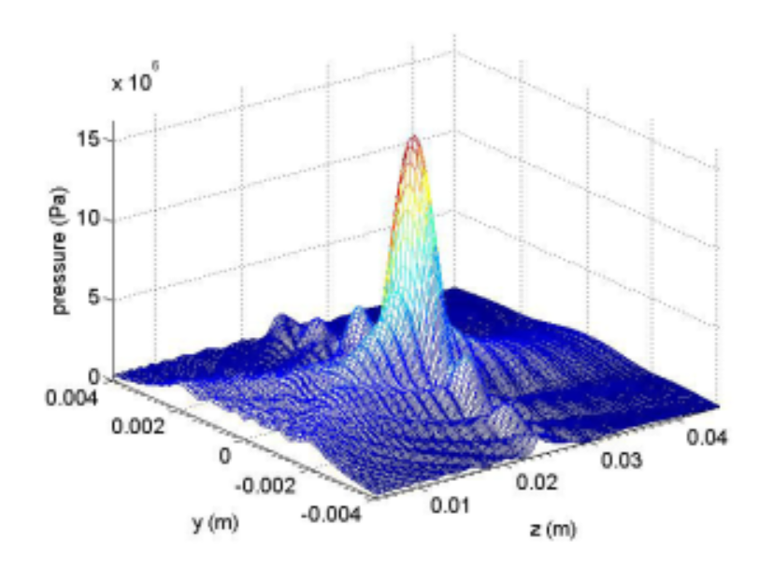
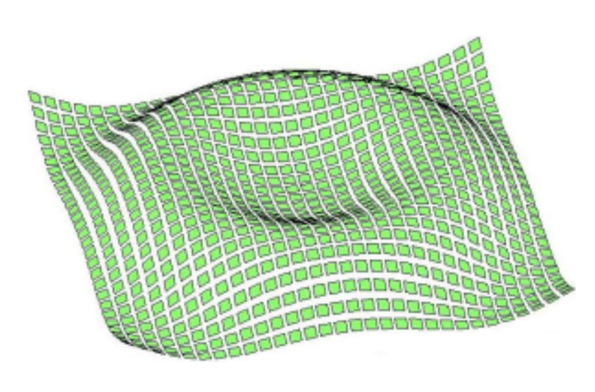
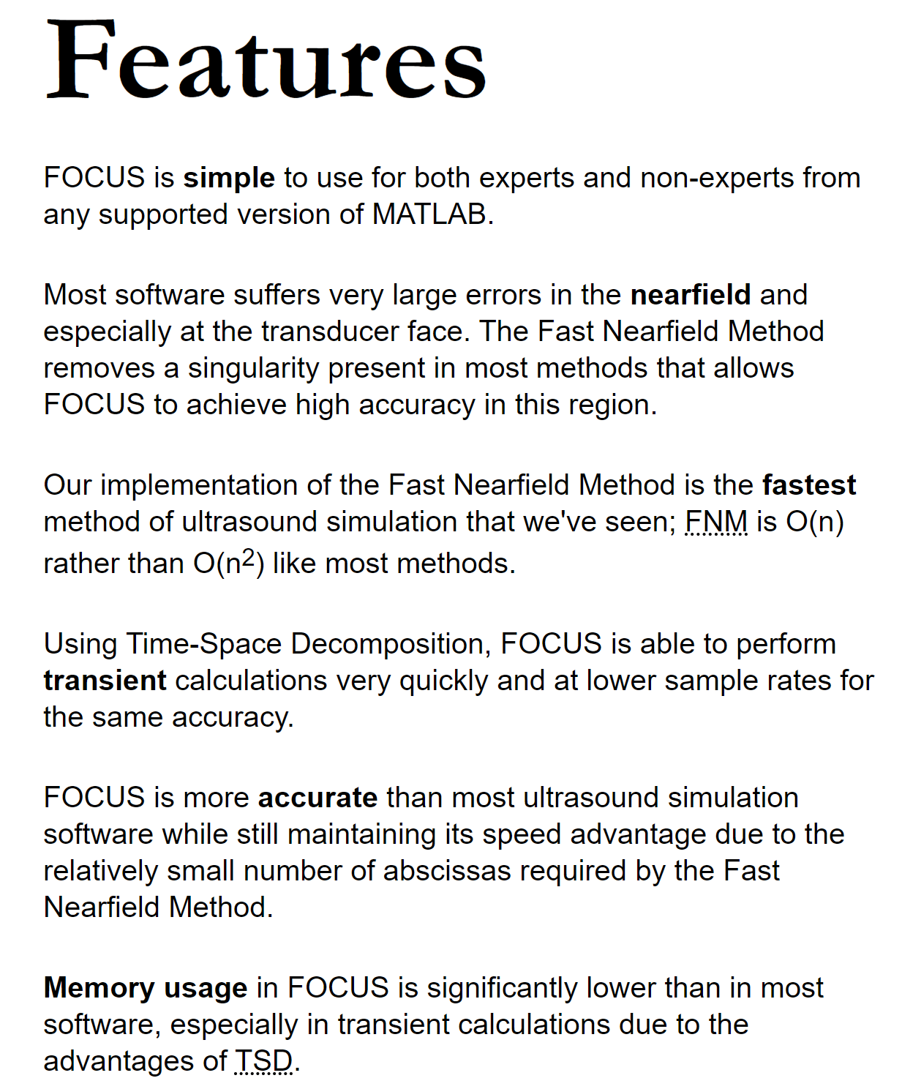
Background & Motivation
Applications of FOCUS
Medical Treatment
Histotripsy
Lithotripsy
Image Processing
Synthesizing Data
Priorities
Functionality
Simple UI
Robustness
Speed
Accuracy
Source: https://www.egr.msu.edu/~fultras-web/index.php

Slide 3
Methods & Results
Methods
MATLAB
Standard for the Group
Plotting for Debugging
Finite Difference Method for Speed
Need to Control Stability
Functions Created
1D Fixed End String Simulation
2D Fixed Ends Planar Simulation
1D Fixed Force Fixed String Simulation

Slide 4
Future Work
-Finite Difference Method in 1D and 2D – done
-Finite Volume Method 1D, 2D, and 3D
-Discontinuous Galerkin Method 1D, 2D, and 3D
-Parallelize Code in C++ for the HPCC

